Slide 1
CSE 4165: Web Programming
Lecture 4

Slide 2
Contents
1. Flexbox Layout
2. Grid Layout
3. Form

Slide 3
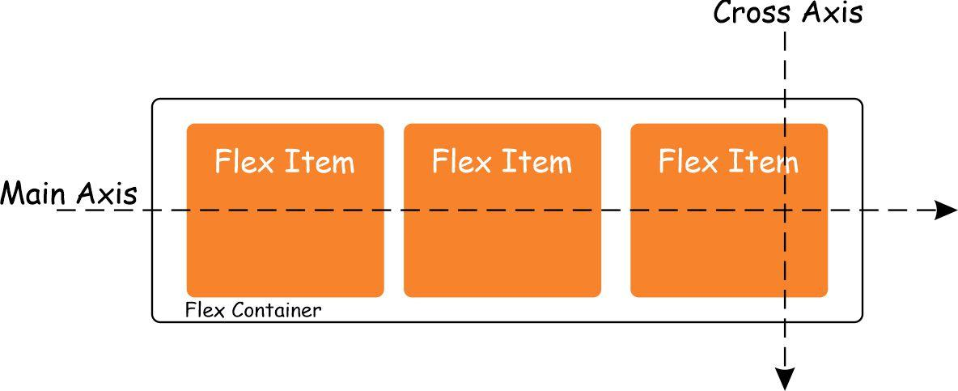
Flex
We at first set a container as a flex container.
You can visualize a flex container in the following way:

Slide 4
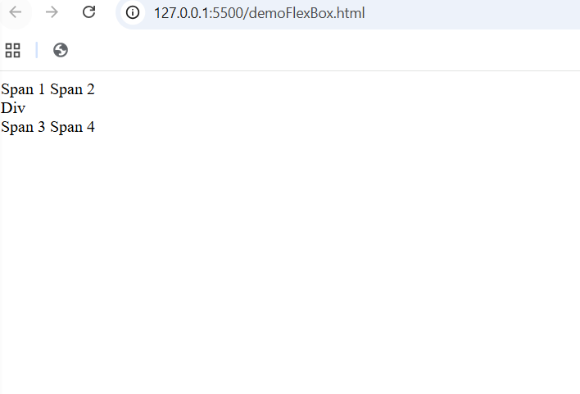
Let us make a flex container and place some flex elements inside
Start by making a simple div.
Place 4 spans inside it with a div in the middle.

Slide 5
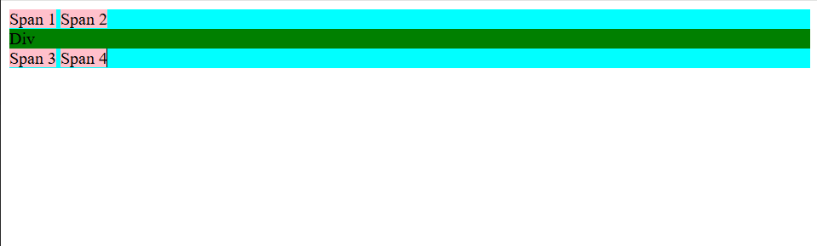
Let us make a flex container and place some flex elements inside
Place some colors

Slide 6
Let us make a flex container and place some flex elements inside
Let us explore some flex properties (for both the container and flex elements)

Slide 7
Flex Container Properties
Flex container properties (6)
1. display
flex → Makes the element a block-level flex container (takes full width).
inline-flex → Makes it a flex container but inline (fits only its content width).
2. flex-direction
row (default) → Items are placed left to right.
row-reverse → Items are placed right to left.
column → Items are placed top to bottom.
column-reverse → Items are placed bottom to top.

Slide 8
Flex Items
Inside a flex container, all child elements become flex items/elements — not block elements and not inline elements.
Flex items behave similar to block elements (they can have width, height, padding, etc.), but they are not true block elements.
Their size, alignment, and behavior are strongly influenced by the flex container’s properties, which makes them more flexible but also more dependent on the parent.

Slide 9
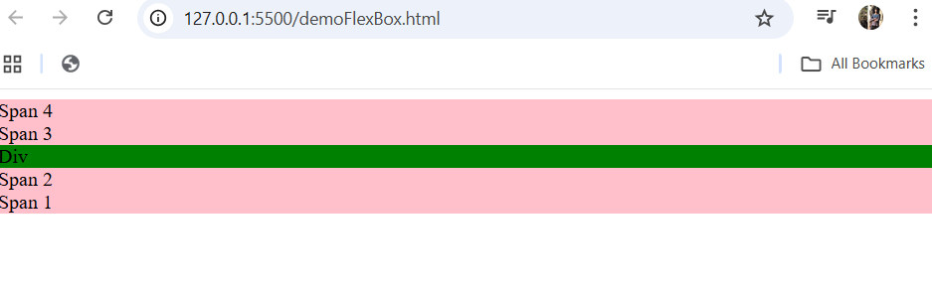
Flex Container Properties
Play around with the display and flex direction properties.
You will get several orientations, including this

Slide 10
Flex Container Properties
Flex container properties (6) – set a width and height for the main container first in order to understand this
3. justify-content: Aligns items along the main axis(main axis = left ↔ right when in row, or top ↕ bottom when in column).
flex-start (default) → Items stick to the start of the main axis.
flex-end → Items stick to the end of the main axis.
center → Items are centered along the main axis.
space-between → Items have equal space between them, but none at edges.
space-around → Items have space on both sides, edges have half spacing.
space-evenly → Equal spacing everywhere (between items + edges).

Slide 11
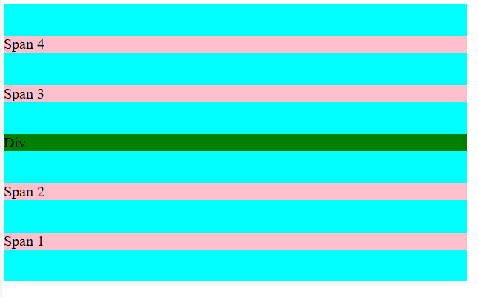
Flex Container Properties
May see something like this (or something else based on the values you have placed so far for the three properties)

Slide 12
Flex Container Properties
May see something like this (or something else based on the values you have placed so far for the three properties)

Slide 13
Flex Container Properties
4. align-items : Aligns items on the cross axis(cross axis = perpendicular to the main axis).
stretch (default) → Items stretch to fill the cross-axis (height in row layout).
flex-start → Items align to the start of the cross axis.
flex-end → Items align to the end of the cross axis.
center → Items align in the middle of the cross axis.

Slide 14
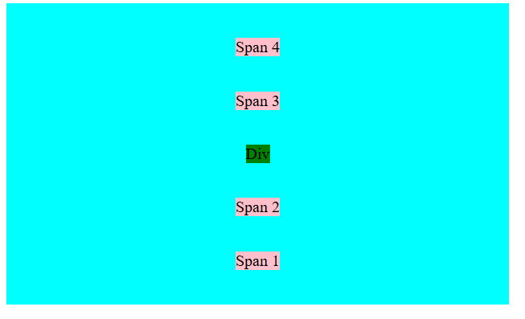
Flex Container Properties

Slide 15
Flex Container Properties
5. gap :Controls spacing between flex items
gap: <length> → Same gap between rows and columns. Example: gap: 20px;
gap: row-gap column-gap → Different spacing for rows and columns. Example: gap: 20px 10px;20px = vertical space10px = horizontal space

Slide 16
Flex Container Properties
6. flex-wrap - Controls whether items stay on one line or wrap to new rows.
nowrap (default) → Items stay on one line, shrink if needed.
wrap → Items move to a new line when there’s no space.
wrap-reverse → Items wrap but in the reverse direction.

Slide 17
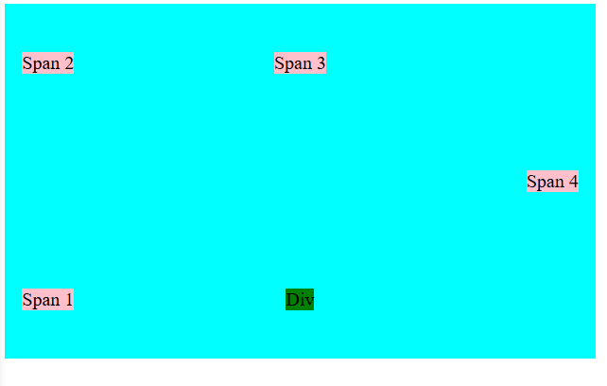
Flex Container Properties

Slide 18
Flexbox Properties for the ITEMS (Children)
These properties go on individual flex items, not the container.
flex-grow - Defines how much an item can grow to fill space.
0 (default, does not grow)
1 or more (grows)
flex-shrink - Defines how much an item can shrink if needed.
1 (default, can shrink)
0 (do not shrink)
flex-basis - Sets the initial size of an item.
auto (default)
any length: 100px, 20%, etc.4.

Slide 19
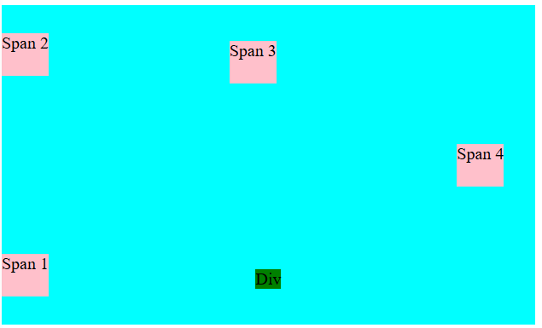
Flexbox Properties for the ITEMS (Children)
These properties go on individual flex items, not the container.
flex (shorthand for grow, shrink, basis)
Examples:flex: 1; → grow equally, auto basis
flex: 1 0 200px;
align-self Overrides align-items for a single item.
auto (default)
flex-start
flex-end
Center
Stretch
baseline

Slide 20
Make a flex container within flex container
Exercise :
Make a flex container. Place 3 divs in it side by side
Make the middle div another flex container, place 3 spans in it from to bottom.

Slide 21
Grid
CSS Grid is a two-dimensional layout system.
This means it lets you control rows AND columns at the same time.
Flexbox = 1D
Grid = 2D

Slide 22
Grid Container Properties
display: grid
Enables CSS Grid on the container.
grid-template-columns : Defines how many columns the grid has.
grid-template-columns: 200px 200px 200px;
grid-template-columns: 1fr 1fr 1fr;
grid-template-columns: repeat(3, 1fr);
grid-template-columns: 100px auto 100px;

Slide 23
Grid Container Properties
grid-template-rows: Defines the height of rows.
grid-template-rows: 100px 100px;
grid-template-rows: auto auto;
grid-template-rows: repeat(2, 150px);
gap / row-gap / column-gap : Controls spacing between grid cells.
gap: 20px;
row-gap: 10px;
column-gap: 30px;

Slide 24
Grid Container Properties
justify-items: Aligns items horizontally inside each cell.
start
center
end
stretch (default)
align-items: Aligns items vertically inside each cell
start
center
end
stretch

Slide 25
Grid Element Properties (not block, inline, or flex)
grid-column : Controls how many columns an item spans.
grid-column: 1 / 3; /* from column 1 to 3 */
grid-column: span 2; /* span 2 columns */
grid-row : Controls how many rows an item spans.
grid-row: 2 / 4;
grid-row: span 2;
justify-self : Aligns an individual item horizontally. Values: start, center, end, stretch
align-self : Aligns an individual item vertically. Values: start, center, end, stretch
grid-area : A shorthand for placing an item using: grid-row-start / grid-column-start / grid-row-end / grid-column-
Example : grid-area: 1 / 1 / 3 / 4;

Slide 26
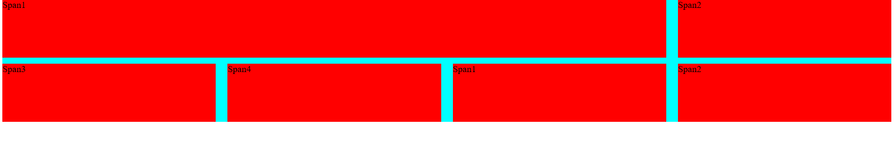
Grid Layout
The elements inside are grid items
Grids can be inserted inside grids

Slide 27
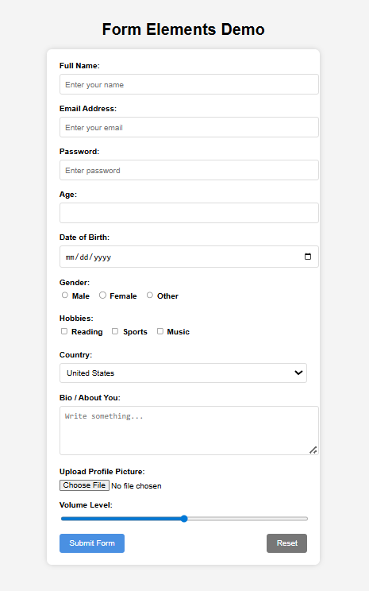
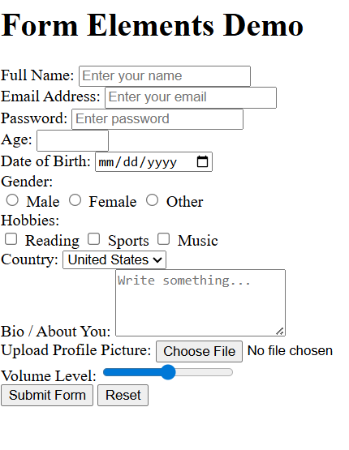
Download the form code
Use the things you learned so far!

Slide 28
Thank You

